Slide 1
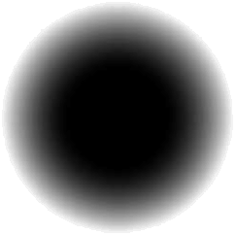


Discrete Mathematics
Presentation
Submitted By
Shammi Akter Nowrin
ID: 251311015
Semester: 2nd,
Section: A
Submitted To
Sanjoy Kumar Chakravarty
Associate Professor,
Dept of CSE,
Rajshahi University

Slide 2


TOPIC
Converting English Sentences to Logical Expressions and Vice Versa
Using Predicates and Quantifiers

Slide 3


Introduction
What Are Predicates and Quantifiers?
Predicates
Universal Quantifier (∀)
Existential Quantifier (∃)
A property or relation involving variables, e.g., P(x): "x is even." Predicates are the building blocks of logical statements, assigning characteristics or relationships to subjects.
"For all x"—asserts a property holds for every element in the defined domain. It signifies that a statement is true without exception for every member of a set.
"There exists x"—asserts the property holds for at least one element within the domain. This indicates that a statement is true for at least one specific member of a set, not necessarily all.

Slide 4
Understanding Universal Truths
Example 1: Universal Quantification
"All students are intelligent."
01
02
03
Define Predicates
Formulate Logical Expression
Interpret Meaning
S(x): "x is a student"
∀x (S(x) → I(x))
For every x, if x is a student, then x is intelligent.
I(x): "x is intelligent"
This statement asserts that the property of being intelligent is universally true for all individuals who are students.

Slide 5

Identifying Specific Instances
Example 2: Existential Quantification
"There exists a student who is tall."
01
02
03
Define Predicates
Formulate Logical Expression
Interpret Meaning
S(x): "x is a student"
∃x (S(x) ∧ T(x))
There is at least one x such that x is a student AND x is tall.
T(x): "x is tall"
This implies that among all individuals, there is at least one who satisfies both conditions simultaneously.

Slide 6

A Complex Scenario
Conversion Challenge
"Nobody except Rohan and Salman is walking home."
Logical Expression
Domain: all people
∀x (P(x) → (x = R ∨ x = S))
Constants: R= Rohan,S=Salman
Predicate: P(x): "x is walking home"
Meaning
If someone is walking home , then that someone is either Rohan or Salman .This statement strictly limits the set of people walking home to only these two individuals.

Slide 7
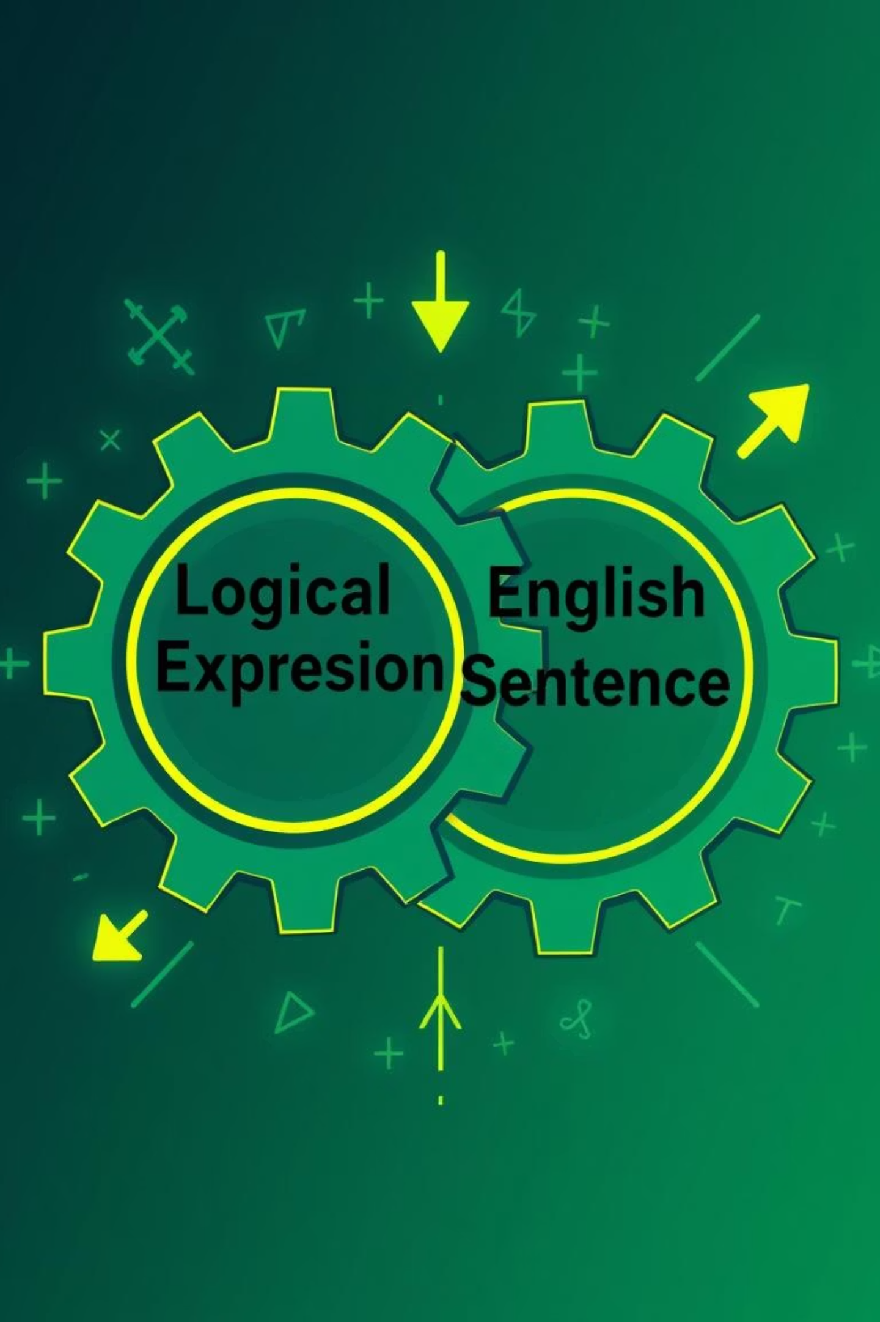
Reverse Engineering Logic
From Logical Expression Back to English
Example 1: Universal Statement
Example 2: Existential Statement
Logical: ∀x (Student(x) → Human(x))
Logical: ∃x (Prime(x) ∧
Even(x))
Translate: "For every x, if x is a student, then x is human."
Translate: "There exists an x such that x is prime and x is even."
Natural English: "All students are human."
Natural English: "There is a prime number that is even."

Slide 8

Conclusion
Predicates and quantifiers bring clarity to logical reasoning.
They allow conversion between natural language and logical form.
Widely used in mathematics, computer science, and Al.

Slide 9
Thank
You

